Slide 1

Chapter 14
Functions of Several Variables and Partial Differentiation
(多元函数和偏导数)
In this Chapter, we will know some important concepts.
Limits and Continuity
Partial Derivatives (偏导数)

Slide 2
Section 14.1 Functions of Several Variables
Real-valued function of two real variables
A function f assigns to each ordered pair (x,y) in some set D of the plane a unique real number f(x,y).
We sometimes write
The set D is called the domain of the function. The range of a function is its set of values. If z=f(x,y), we call x and y the independent variables and z the dependent variable.

Slide 3
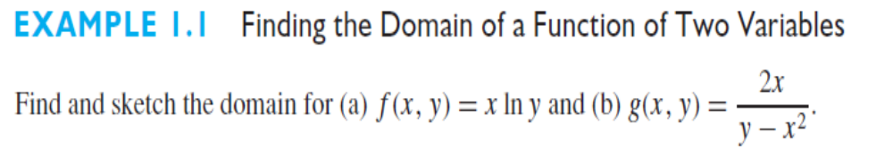
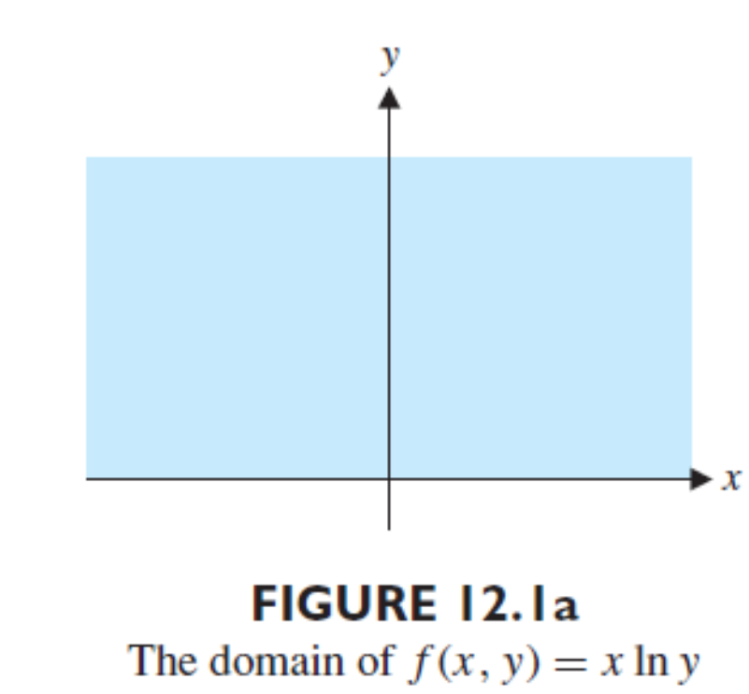
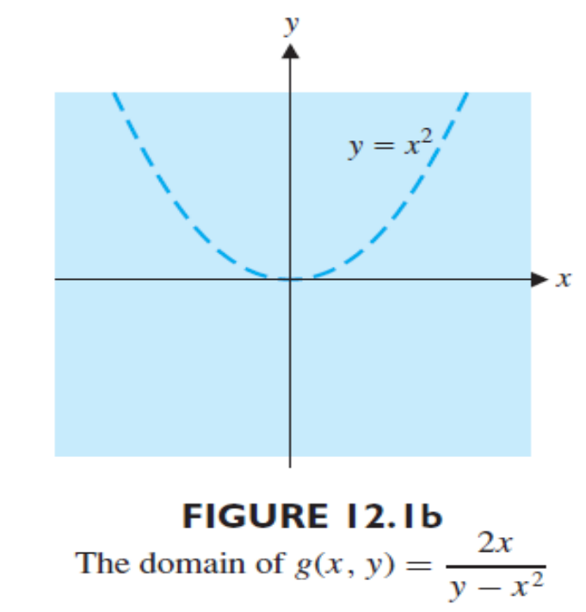

Slide 4
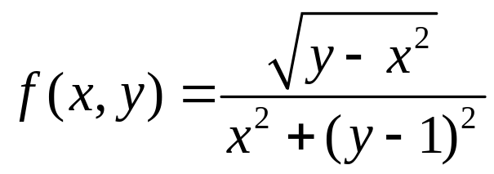
Exercise 1
In the xy-plane, give the natural domain for

Slide 5
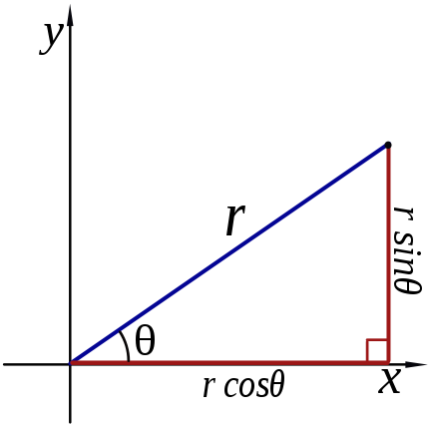
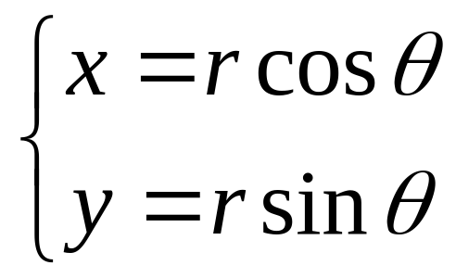
The Polar Coordinate System (极坐标系)
In mathematics, the polar coordinate system is a two-dimensional coordinate system in which each point on a plane is determined by a distance from a fixed point and an angle from a fixed direction.

Slide 6
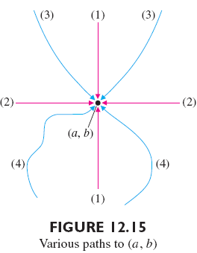
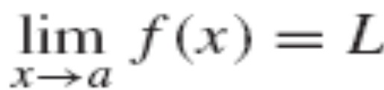
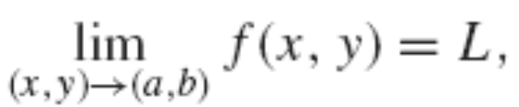
Section 14.2 Limits and Continuity
Limits
Recall: for a function of a single variable
For a function of two variables

Slide 7
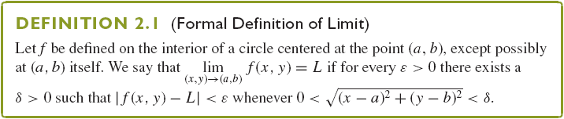
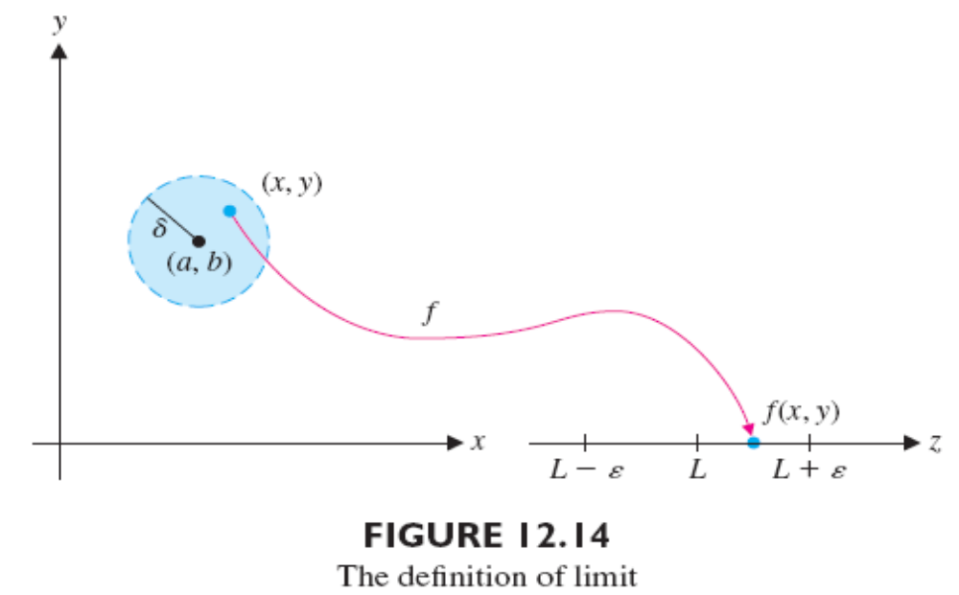

Slide 8
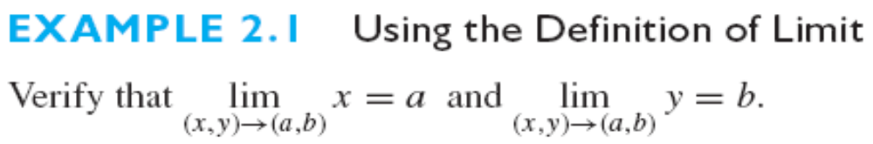
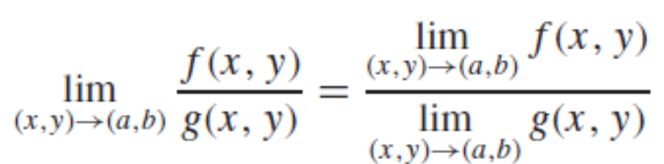
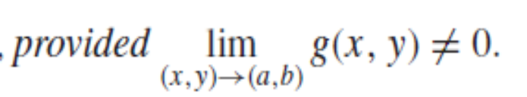

Slide 9
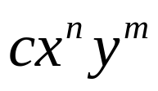

A polynomial in the two variables x and y is any sum of terms of the form , where c is a constant and n and m are nonnegative integers.
Rational function

Slide 10
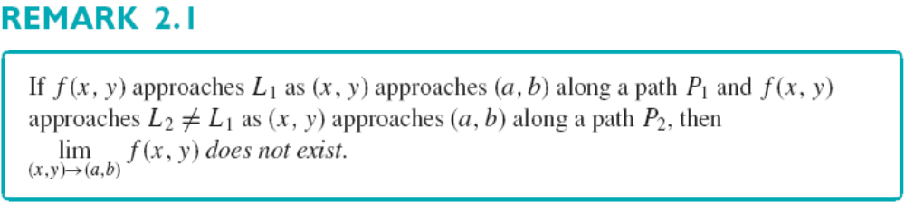
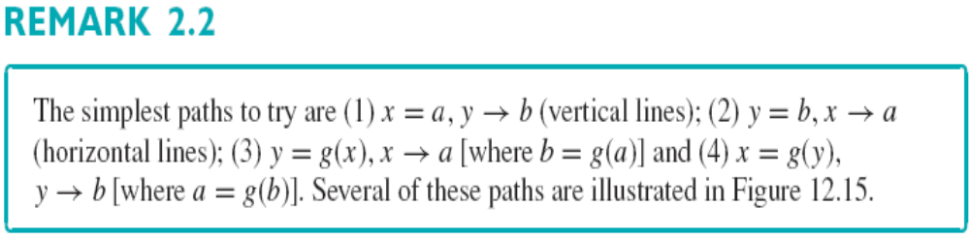
Recall: for a function of a single variable, we have the following result:
If left-hand limit and right-hand limit exist and are not equal, then limit does not exist.

Slide 11

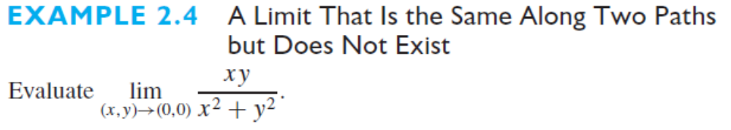
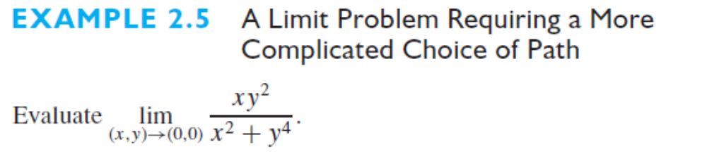

Slide 12
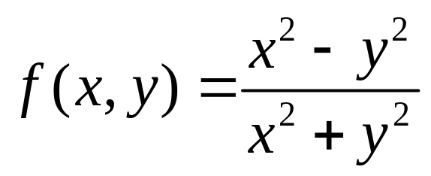
Exercise
Show that the function f defined by
has no limit at origin.

Slide 13
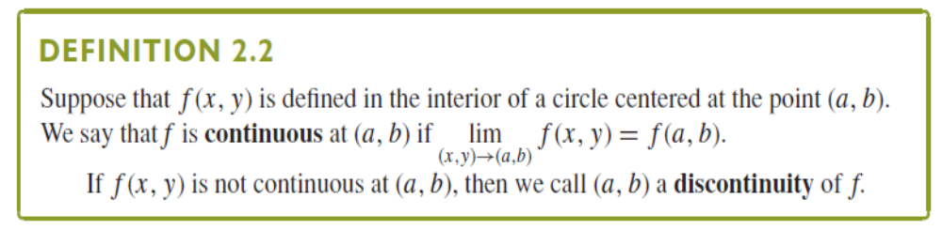
Continuity (连续性)

Slide 14
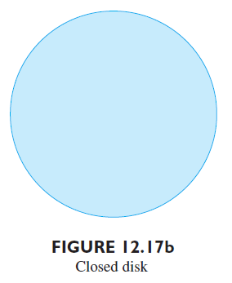
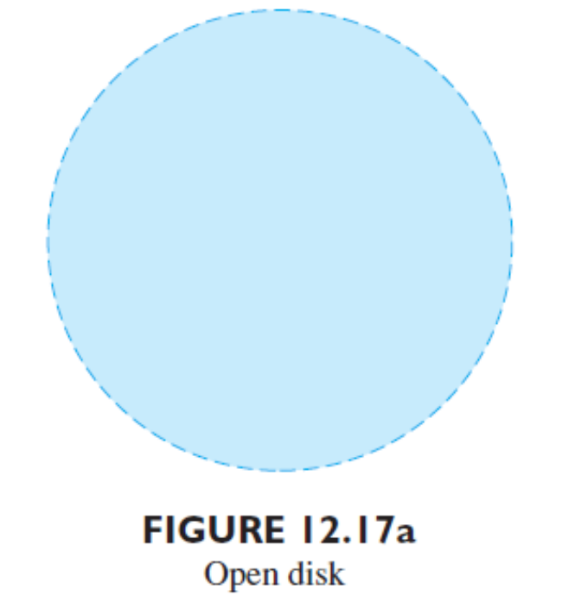
A Close Set and An Open Set
An Open Disk: The interior of a circle.
A Close Disk consists of the circle and its interior.

Slide 15
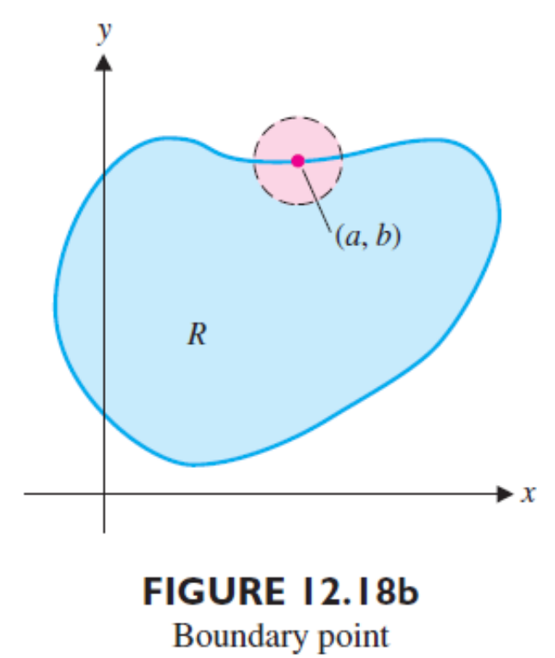
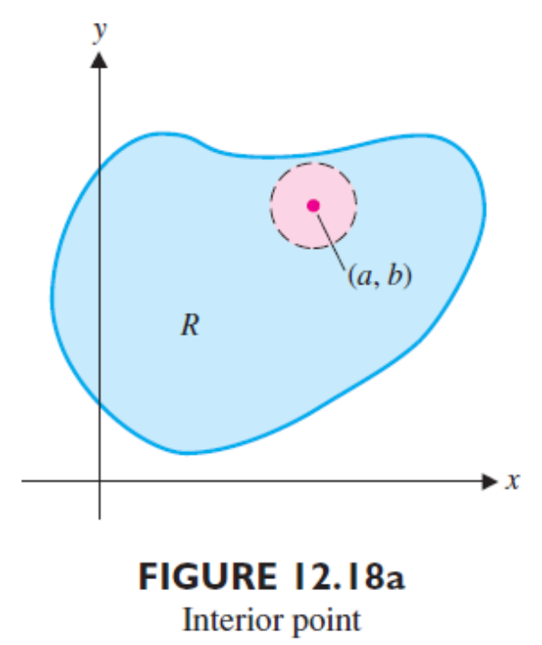
An Interior point of R
There exists an open disk centered at (a,b) that lies
completely inside of R
A boundary point of R
Every open disk centered at (a,b) contains points in
R and points outside R.

Slide 16
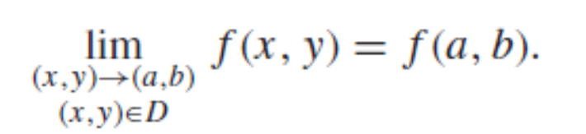
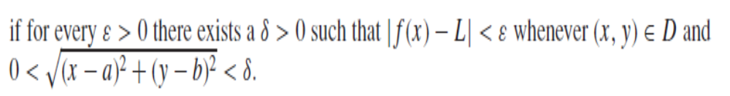
If (a,b) is a boundary point of the domain D of a
function f, we say that f is continuous at (a,b) if

Slide 17
A closed set R
It contains all of its boundary points.
An open set R
It contains none of its boundary points.
We say that a function f(x,y) is continuous on a
region R if it is continuous at each point in R.

Slide 18
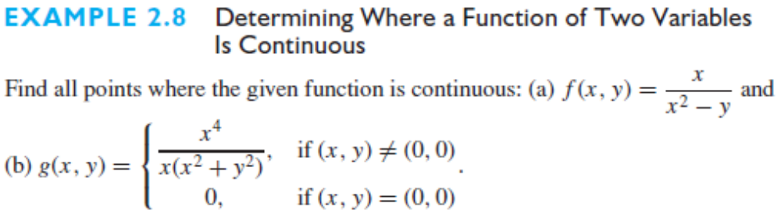
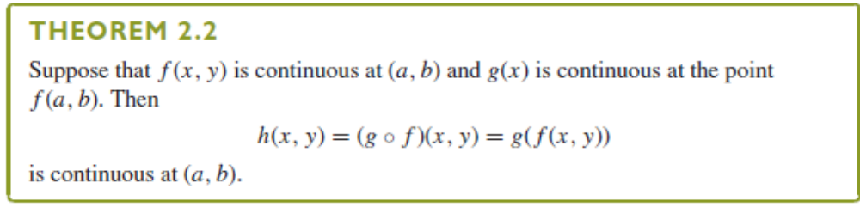


Slide 19
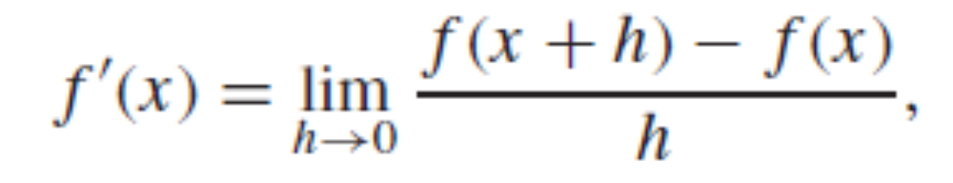
Section 14.3 Partial Derivative (偏导数)
Partial Derivative
Recall that for a function f of a single variable, we define the derivative function as

Slide 20
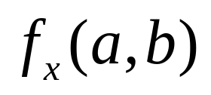
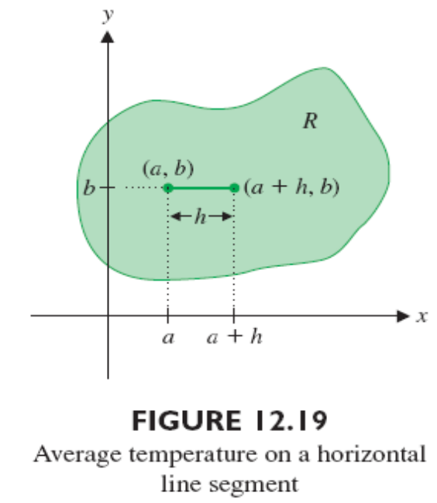
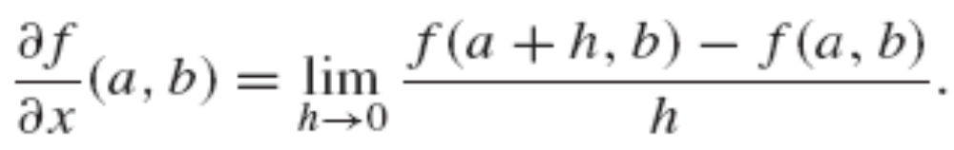
Suppose that f is a function of two variables x and y. If y is held constant, say y=b, then f(x,b) is a function of the single variable x. Its derivative at x=a is called the partial derivative of f with respect to x at (a,b) and it denoted by

Slide 21
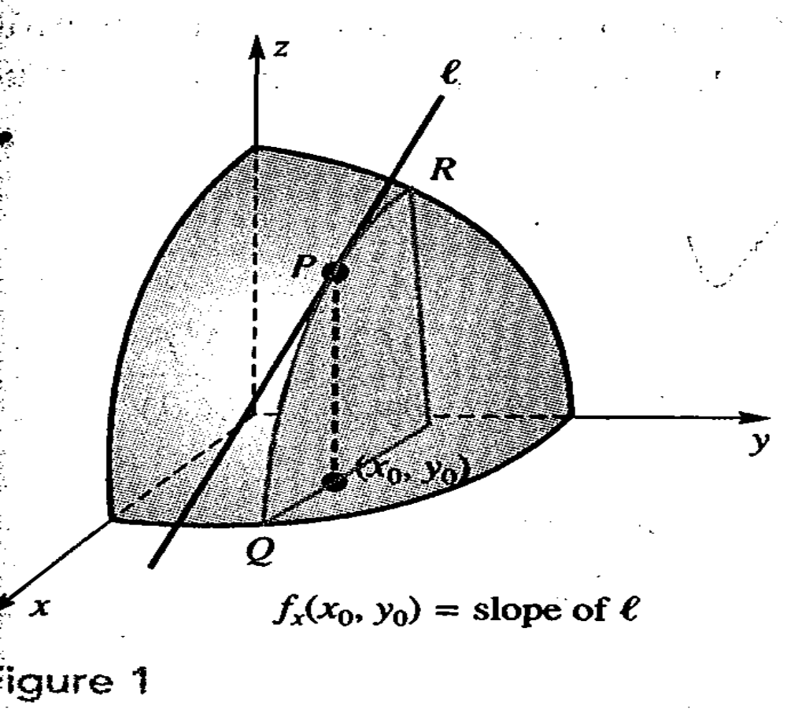

Slide 22
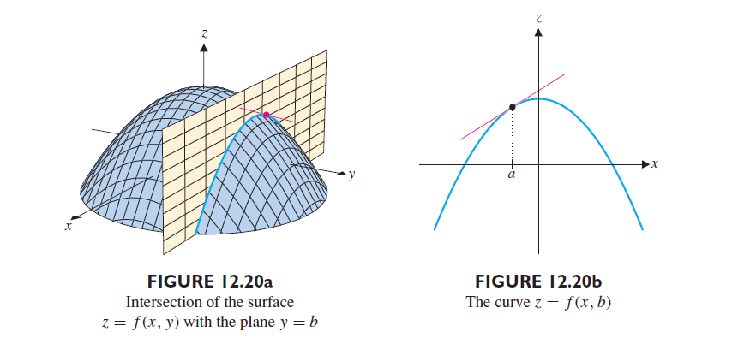
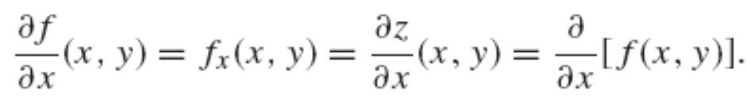
Some common used notations:

Slide 23
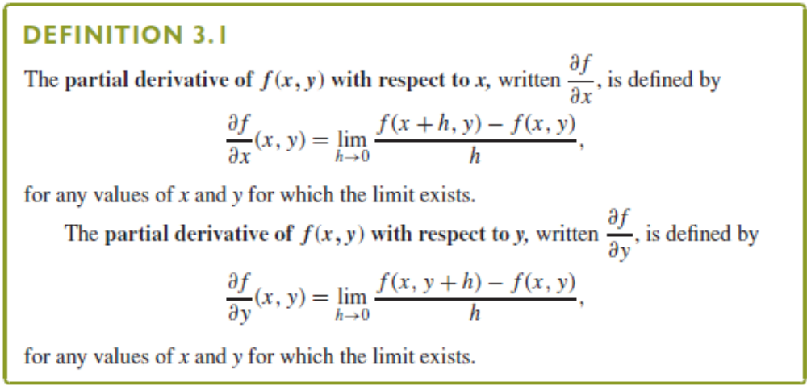

Slide 24
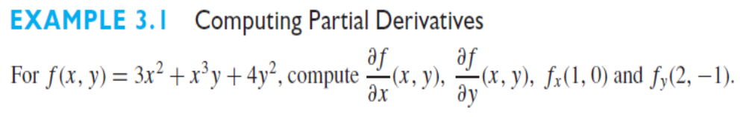
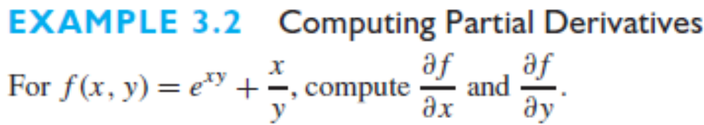

Slide 25
partial derivatives of a function exist at the point
A function is continuous at that point

Slide 26
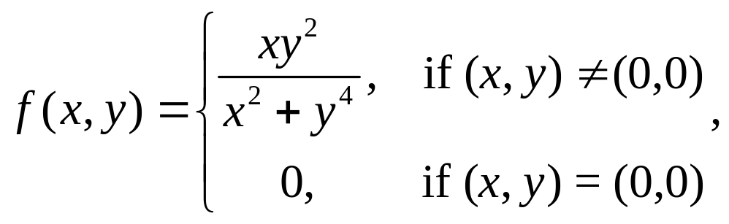
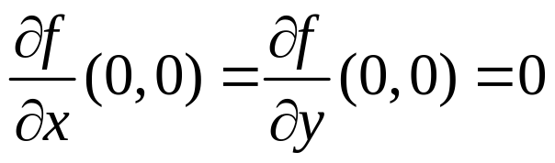
Example
For the function
Show that
But this function is not continuous at (0,0).

Slide 27
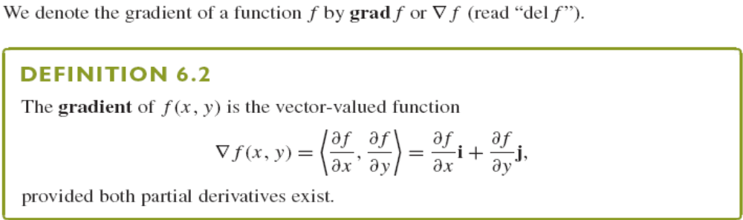


Gradient (梯度)
Where as .

Slide 28
Chapter 15
Multiple Integrals (多元积分)
In this Chapter, we will know some important concepts.
Double Integrals (重积分)
Change of Variables in Multiple Integrals

Slide 29
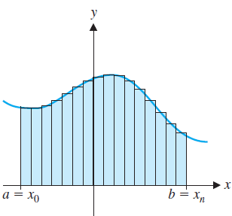
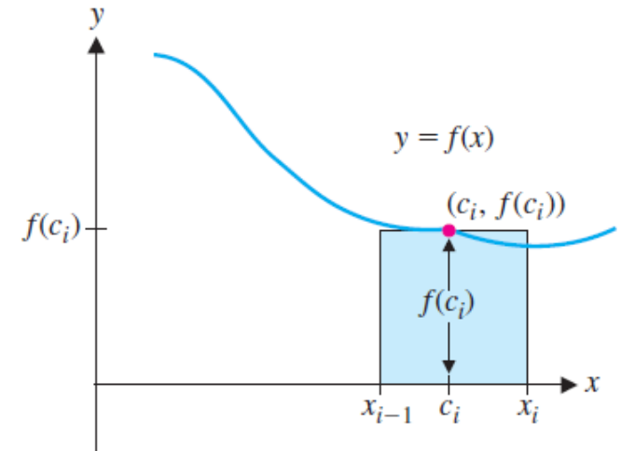
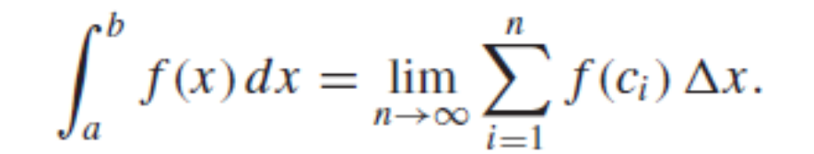
Section 15.1 Double Integrals (重积分)
Integration for functions with one variable

Slide 30
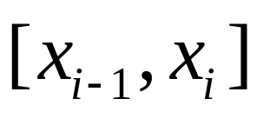
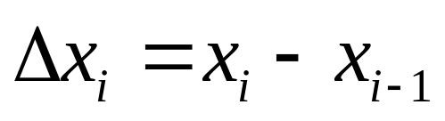
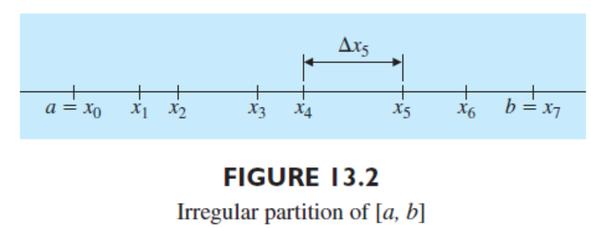
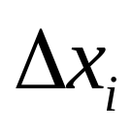
We generalized this by allowing partitions that are irregular.
Define the width of the ith subinterval to be .
Defining ||P|| to be the largest of all the ‘s.

Slide 31
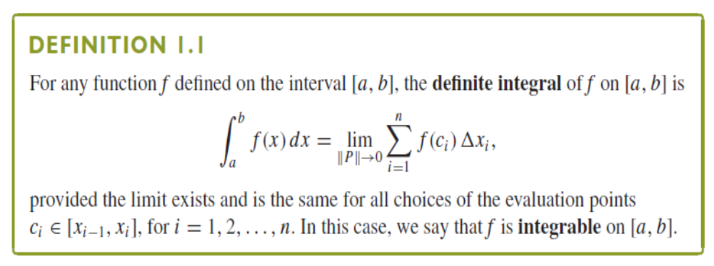

Slide 32

Double Integrals over a Rectangle

Slide 33



Slide 34



Slide 35

Define the norm of the partition ||P|| to be the largest diagonal of any rectangle in the partition.

Slide 36

Iterated Integrals
We first consider the special case where f(x,y) ≥0 on the rectangle
represents the volume lying beneath the
surface z=f(x,y) and above the region R.

Slide 37





Slide 38





Slide 39


Double Integrals and Iterated Integrals

Slide 40

Double Integrals over General Regions
Inner partition of R
Motivation: we want to extend the notion of double integral to a bounded, nonrectangular region like the one shown in following figure.

Slide 41


We resolve this problem by considering only those rectangular sub-regions that lie completely inside the region R called an inner partition of R.

Slide 42




Slide 43



On each rectangular subregion in an inner partition. We also define the norm of the inner partition ||P|| to be the length of the largest diagonal of any of the rectangles

Slide 44

We first consider the case where the region R

Slide 45




Slide 46


Slide 47



Slide 48

We consider another case where the region R

Slide 49


Slide 50



Slide 51



Slide 52



Slide 53


Slide 54


Section 15.3 Double Integrals in Polar Coordinates (极坐标的双重积分)
Polar coordinates prove to be particularly useful for dealing with certain double integrals.
Is there any way to simplify the computation?

Slide 55



Suppose the region R can be written in the form

Slide 56





Slide 57


Slide 58



Slide 59



Slide 60



Suppose the region R can written in the form

Slide 61


Section 15.8 Change of Variables in Multiple Integrals

Slide 62

A Transformation T from the uv-plane to the xy-plane

Slide 63


Example 1

Slide 64


Example 2

Slide 65



To determine how a change of variables in a multiple integral will affect the integral. We consider the double integral

Slide 66




Slide 67



Slide 68


Slide 69



Slide 70




